Slide 1

Computer Store Management System
A Medium-Level Web Application for Hardware Retail Operations, Inventory Control, and Sales Transactions.
University Computer Science Project Jakarta EE + MySQL Stack

Slide 2

Project Overview & Purpose
Designed to streamline retail store operations by bridging inventory control with client sales management in a unified Java Web platform.
Dual Operational Focus: Equips store staff with full administrative controls while offering customers an accessible catalog interface.
Medium Complexity Standard: Moves beyond basic CRUD by incorporating session security, relational integrity, and automated stock processing.
Pure Enterprise Java: Built with core Jakarta EE components running on Apache Tomcat without heavy external framework bloat.
Computer Store Management System Slide 2

Slide 3






Problem Statement
Manual Inventory Logs
Stock Discrepancies
Opaque Sales Records
Paper and spreadsheet-based stock tracking leads to high error rates, misplaced records, and delayed stock updates during peak sales hours.
Inability to track real-time hardware quantities results in overselling items, unexpected stockouts, and dissatisfied store customers.
Lack of centralized transaction logs complicates daily auditing, customer order history lookup, and quick store report generation.
Computer Store Management System Slide 3

Slide 4



Project Objectives
Centralized Data
Automated Stock Control
Role-Based Access Control
Establish a unified MySQL database mapping products, brands, categories, sales, and user accounts under strict relational integrity constraints.
Implement automatic stock deduction upon transaction confirmation, enforcing rules to prevent negative product inventory.
Secure administrative capabilities via HTTP Session management, separating store staff controls from general customer features.
Computer Store Management System Slide 4

Slide 5


System Scope & Boundaries
Functional Inclusions
Express Exclusions
•
Product, Category & Brand Catalog Management
•
Online third-party payment gateways (Credit/PayPal)
•
Stock tracking with Low-Stock indicator alerts
•
Microservices or complex cloud infrastructure
•
Staff sales processing & invoice receipt generation
•
AI/ML product recommendation algorithms
•
Customer product search, filtering, & purchase history
•
Mobile native apps & Bluetooth/Barcode scanners
•
Session authentication & role-based route guard
•
Complex distributed multi-store synchronization
•
Basic sales & stock summary reports
Computer Store Management System Slide 5

Slide 6

User Roles & Access Permissions
Functional Module | Staff / Administrator | Common User / Customer
Authentication & Profile | Login, Logout, View/Edit Staff Profile | Register, Login, Logout, Edit Profile
Product & Brand Catalog | Full CRUD (Add, Edit, Delete, Categorize) | Read-Only (Browse, Search, Filter)
Inventory & Stock | Adjust Stock, View Low-Stock Alerts | View Stock Status (In-Stock / Out-of-Stock)
Sales & Transactions | Process Sales, Check Out, Print Invoices | Submit Purchase Request / Order
Reports & Dashboard | Access Store Financials & Sales Reports | Access Personal Purchase History Only
Computer Store Management System Slide 6

Slide 7












Core System Architecture Modules
1. Auth Module
2. Product Catalog
3. Inventory Control
Handles registration, password validation, session creation, and role guards.
Manages hardware specs, pricing, images, categories, and brand tags.
Tracks current quantities, updates stock on sale, and monitors thresholds.
4. Sales Processing
5. Search Engine
6. Reports & Metrics
Calculates order subtotals, records sale items, and creates receipts.
Multi-criteria query filter by keyword, brand, and hardware category.
Generates daily/monthly sales reports and stock movement summaries.
Computer Store Management System Slide 7

Slide 8





System Architecture (MVC Pattern)
User Browser
JSP Views
Servlet Control
DAO & JDBC
MySQL DB
Bootstrap HTML/JS Interface
Dynamic Presentation Pages
Request Handling & Routing
Database Access Layer
Relational Data Storage
Controller (Jakarta Servlets): Receives HTTP POST/GET requests, validates user session parameters, invokes service logic, and determines next view navigation.
Model (Java Beans & DAO): Encapsulates data objects (Product, Sale, User) and handles SQL execution through JDBC prepared statements.
View (JSP & JSTL): Renders data sent from Servlets dynamically using JSTL tags without embedding raw Java scriptlets.
Computer Store Management System Slide 8

Slide 9

MySQL Relational Database Schema
Table Name | Primary Key (PK) | Foreign Keys (FK) | Key Attributes & Purpose
users | user_id | None | full_name, email, username, password, address
staff | staff_id | None | full_name, email, username, password, role
categories / brands | category_id / brand_id | None | category_name, brand_name, description
products | product_id | category_id, brand_id | product_name, specs, price, status, image
inventory | inventory_id | product_id | quantity, last_updated (1-to-1 with products)
sales | sale_id | user_id, staff_id | sale_date, total_amount, status
sale_items | sale_item_id | sale_id, product_id | quantity, unit_price, subtotal (Junction table)
Computer Store Management System Slide 9

Slide 10
Core Business & Validation Rules
Stock Availability Guard: A transaction can only be processed if available_quantity >= requested_quantity. Inventory cannot become negative.
Automatic Stock Adjustment: Product inventory is instantly decremented upon successful transaction confirmation inside a JDBC transaction block.
Transaction Integrity: Every sale record must be associated with a valid customer, authorized staff member, and at least one line item.
Data Historical Preservation: Deleting or soft-deleting a product does not remove or alter past historical sales transactions or invoice logs.
Data Privacy & Security: Customers are restricted to accessing their own profile and order history via HTTP Session guards.
Computer Store Management System Slide 10

Slide 11




Customer Experience Workflow
2. Filter & Details
4. Purchase & History
Filters hardware by brand/category and inspects price & specs.
Submits order request and views confirmation in purchase logs.
1. Login & Catalog
3. Stock Check
Authenticates customer session & opens store catalog page.
System verifies real-time product availability in stock.
Computer Store Management System Slide 11

Slide 12

Staff Sales Processing Workflow
2. Build Transaction
4. Generate Receipt
Selects customer, adds requested products, and enters quantities.
Prints sales receipt and logs entry into system stock history.
1. Staff Auth
3. Confirm & Deduct
Staff logs into administrative console and opens Sales Terminal.
Calculates totals, writes sale record, & auto-deducts inventory.
Computer Store Management System Slide 12

Slide 13
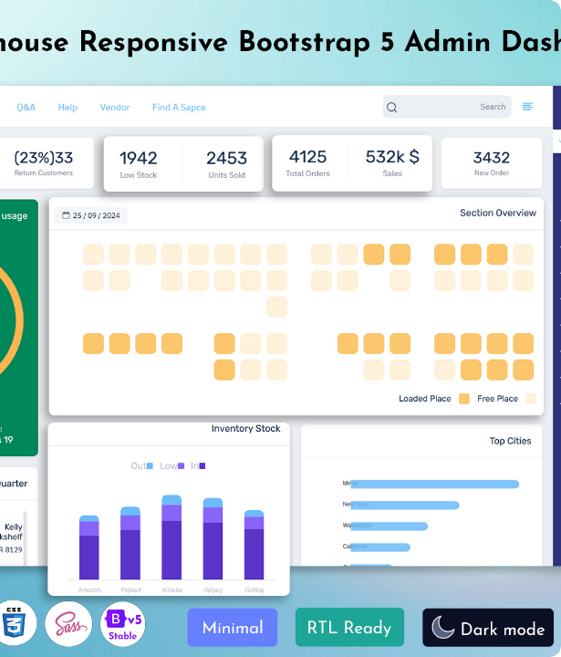
System UI & Dashboard Design
Responsive Bootstrap Interface
The front-end utilizes clean Bootstrap layout components to provide intuitive navigation for both technical store staff and end-user customers.
Admin Dashboard: Real-time KPI summary widgets displaying total products, low-stock warnings, and revenue metrics.
Customer Portal: Card-based product grids with brand badges, stock pill indicators, and quick specification popups.

Slide 14

Complete Technology Stack
Layer / Technology | Specific Component | Role in System
User Interface | HTML5, CSS3, JS, Bootstrap 5 | Provides responsive view pages, forms, and dynamic tables.
Server-Side Platform | Jakarta EE (Servlet 5.0 / JSP) | Handles HTTP requests, session management, and routing.
Architecture Pattern | MVC (Model-View-Controller) | Decouples UI views from business logic and database access.
Database Access | JDBC (Java Database Connectivity) | Executes parameterized SQL queries & manages transactions.
Database Engine | MySQL RDBMS | Stores relational user, product, inventory, and sales data.
Web Server & Environment | Apache Tomcat 10 / Eclipse IDE | Runs Servlet container and hosts application deployment.
Computer Store Management System Slide 14

Slide 15


Benefits, Limitations & Future Scope
System Benefits
Future Enhancements
• Eliminates manual stock tracking errors with instant database updates.
• Barcode / QR scanner hardware integration for rapid checkout.
• Enforces role authorization and strict stock availability rules.
• Email notifications for low stock alerts & digital receipts.
• Demonstrates enterprise Jakarta EE concepts in a clean academic architecture.
• RESTful API endpoints for external mobile application connectivity.
Computer Store Management System Slide 15

Slide 16


Image Sources
https://epcusa.com/wp-content/uploads/sites/9/2021/02/Retail-Glory-Shot-e1783536932903.jpg
Source: epcusa.com
https://multipurposethemes.com/wp-content/uploads/2025/01/Warehouse-Responsive-Bootstrap-5-Admin-Dashboard-1.jpg
Source: multipurposethemes.com

